Slide 1

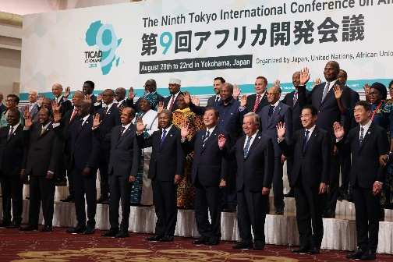
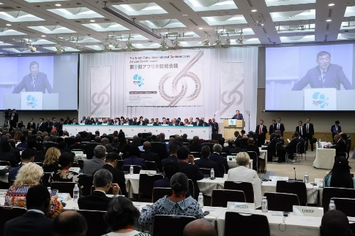
August 2025
Ministry of Foreign Affairs of Japan
The Ninth Tokyo International Conference on African Development (TICAD 9)
(in Yokohama on 20th - 22nd August)
1. Participants
49 African countries participated (including 33 heads of state).
Co-organizers (*) , international organizations, private companies, Diet members, civil society, etc. participated.
Prime Minister Ishiba served as co-chair with Angolan President Lourenço (Chairperson of the African Union (AU)), and held 34 meetings with the leaders in attendance.
Former Prime Minister Kishida served as acting co-chair of TICAD 9 and conducted the proceedings of the Plenary Sessions.
Foreign Minister Iwaya served as co-chair of the TICAD 9 Ministerial Preparatory Meeting held on Tuesday the 19th, and during TICAD 9 he held 30 meetings with attending ministers and other officials (including a breakfast meeting with the heads of major international organizations).
State Minister for Foreign Affairs Fujii, Parliamentary Vice-Minister for Foreign Affairs Matsumoto, and Parliamentary Vice-Minister for Foreign Affairs Eri attended various thematic events and held meetings with representatives of international organizations.
* United Nations, UNDP, World Bank, African Union Commission (AUC)
Group photograph of the participants
2. Key Points
Opening Ceremony
Discussions took place in the fields of economy, society, and peace and stability, with the theme of "co-create innovative solutions with Africa." Focused on cross-cutting priorities such as private sector-led sustainable growth, youth and women, and regional integration and connectivity within and beyond the region.
Prime Minister Ishiba announced that Japan will accelerate its efforts in the following seven areas: (1) Promoting investment in Africa, 2) Promoting the mobilization of private capital, 3) Strengthening industrial cooperation, including the use of AI and DX and strengthening the resilience of mineral resource supply chains, 4) Enhancing connectivity within and beyond Africa, 5) Strengthening health policies, 6) Human resource development and exchanges focusing on youth and women, and 7) Progressing efforts toward peace and security in Africa.
Specifically, Prime Minister Ishiba announced the following specific initiatives: Economic Region Initiative of Indian Ocean-Africa; Region-wide co-creation for common agenda initiative through Nacala Corridor Development; Establishment of Public-Private-Academia Joint Study Group on Strengthening of Japan-Africa Economic Partnership; African Healthcare Investment Promotion Package.
The "TICAD9 Yokohama Declaration," a leaders’ declaration, was adopted as an outcome of TICAD 9.
On the occasion of TICAD9, 324 business-related cooperation documents were signed between the public and private sectors of Japan and Africa.
In parallel with the Plenary Sessions, international organizations, private companies, civil society, etc. held more than 200 thematic events.
1

Slide 2
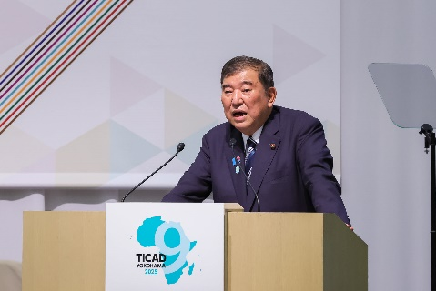
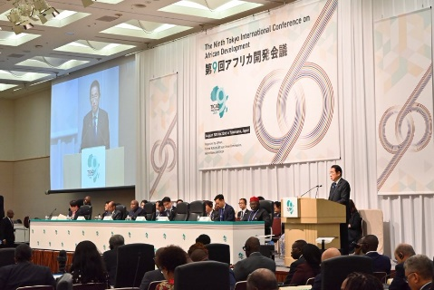
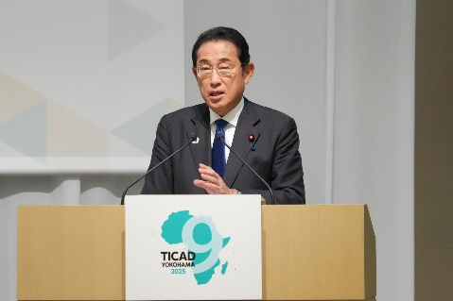
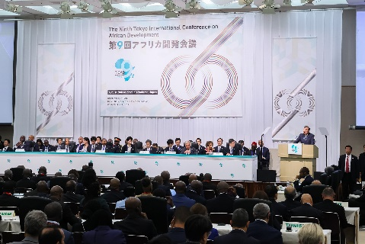
3. Overview of Each Meeting
Opening Ceremony
Prime Minister Ishiba stated that Japan had consistently believed in the future of Africa since the establishment of TICAD in 1993 and would continue to be a reliable partner for Africa. Prime Minister Ishiba also explained the importance of “co-creation of innovative solutions”, which is the theme of TICAD 9, expressed Japan's commitment to working together with Africa to address global challenges, and announced Japan’s specific initiatives.
Angolan President Lourenço, co-chair of the TICAD 9, stressed the importance of mechanisms to facilitate financing necessary for addressing Africa's development challenges, such as health, education, food security, energy infrastructure development, trade, and digitalization. Furthermore, President Lourenço spoke on the importance of peace and security, and UN Security Council reform.
Opening Ceremony
Plenary Session 1 (Peace and Stability)
Former Prime Minister Kishida, who served as acting co-chair of TICAD 9, stated that peace and stability are the foundation of sustainable economic growth and an inclusive society and introduced Japan's initiatives in this area. African countries expressed their expectations for Japan’s initiatives.
Plenary Session 2 (Economy)
Former Prime Minister Kishida introduced Japan's initiatives in relevant fields, including promoting sustainable growth leveraging the vitality of the private sector, strengthening regional integration and connectivity with other regions, and economic diversification by enhancing industrial ecosystems. African countries expressed expectations for further investment of Japanese companies in Africa and strengthened partnerships.
Plenary Session
Plenary Session 3 (Society)
Former Prime Minister Kishida introduced Japan's future initiatives in Africa in the areas of education and human resource development, health, environment, and disaster prevention. African countries pointed out that it is essential to take measures such as improving access to quality education, investment in human capital such as vocational training, empowerment of youth and women, strengthening health systems, water and sanitation, climate change countermeasures, and disaster prevention measures. Furthermore, they expressed expectations for Japan’s initiatives.
Plenary Session
Closing Ceremony and Joint Press Conference
Prime Minister Ishiba stated that Japan will use TICAD 9 as an opportunity to expand investment in Africa's future, strengthen industrial cooperation, and work to develop human resources. Prime Minister Ishiba then stated that Japan will work to continuously develop TICAD into something better, while building upon the original concept of TICAD and heeding the opinions of stakeholders. A declaration document was adopted.
Closing Ceremony
2

Slide 3
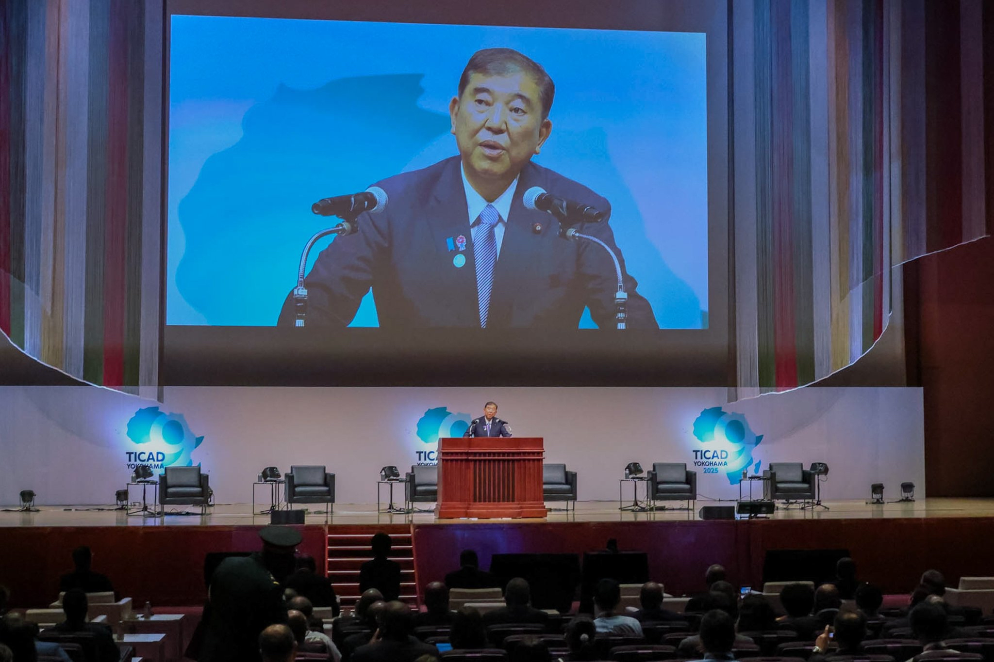
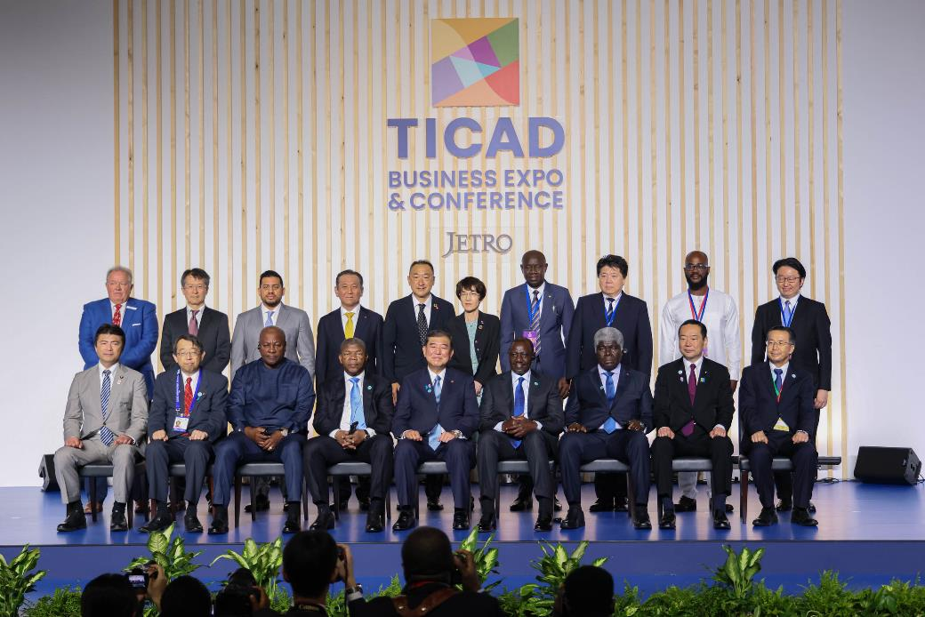
August 2025
Ministry of Foreign Affairs of Japan
TICAD 9 Business-related Events
1. Public-Business Dialogue
Three panel discussions were held by government and private sector representatives from both Japan and Africa. Free and open discussions took place on the themes of "Economic diversification," "Intra-regional African integration and connectivity within and beyond Africa," and "Strengthening finance" in Africa.
Prime Minister Ishiba, Angolan President Lourenço, Minister of Economy, Trade and Industry Muto, AUC Commissioner Vilakati, Chair of Committee on Africa of Keidanren Ohashi, ATIDI CEO Moses made remarks.
Participants, including representatives from Japanese and African companies, attended as an audience, and the event's online broadcast was viewed worldwide.
Through frank exchanges of opinions between both the public and private sectors on topics of great interest between Japan and Africa, momentum was created for working together to deepen economic ties.
Public-Business Dialogue
2. Signing Ceremony
Signing Ceremony
Prime Minister Ishiba participated in a ceremony to unveil a total of 64 cooperation documents among 324 cooperation documents signed at TICAD 9, together with Angolan President Lourenço, Kenyan President Ruto, Ghanaian President Mahama, Ivoirian Prime Minister Mambe, State Minister for Foreign Affairs Fujii, and State Minister of Economy, Trade and Industry Koga.
Prior to the signing ceremony, Prime Minister Ishiba observed the TICAD Business Expo & Conference with Angolan President Lourenço. At the booths of Japanese companies operating in Africa, he received explanations from exhibitors about their business activities and exhibits. Additionally, he visited the Republic of Angola booth within the Africa Lounge and inspected exhibits related to the country's natural environment, traditional crafts, and investment and business environment.
3. TICAD Business Expo & Conference
JETRO held a large-scale event to provide a platform for business exchange between Japan and Africa in the exhibition hall at the TICAD 9 venue, with the aim of expanding business with Africa.
The event featured the Japan Fair (exhibitions by 194 participating companies and organizations), the Africa Lounge for introducing investment environments and fostering exchange among African countries, and an event stage hosting various thematic seminars. Approximately 10,000 participants from both Japanese and African companies attended the event.
3

Slide 4
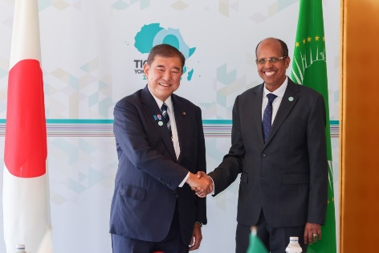
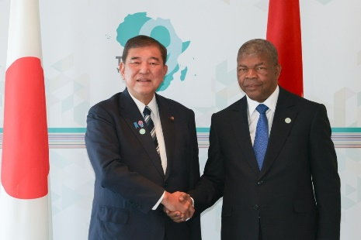
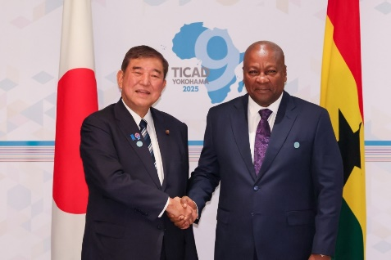
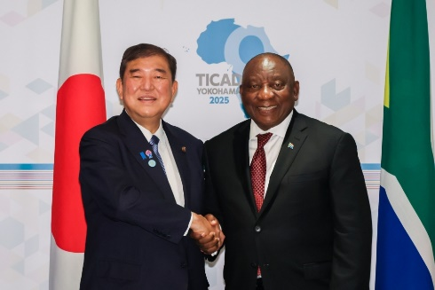
TICAD 9 Bilateral Meetings
August 2025
Ministry of Foreign Affairs of Japan
1. Overview
From August 20 to 22, Prime Minister Ishiba held bilateral meetings with heads of delegations of a total of 34 countries and organizations (32 countries and 2 organizations), while Foreign Minister Iwaya held bilateral meetings with a total of 29 countries and organizations (22 countries and 7 organizations).
Prime Minister Ishiba held meetings with: AUC (Chairperson); Kenya; Liberia; Mauritius (Prime Minister); Senegal; Mauritania; Zimbabwe; Angola; United Nations (Secretary-General); Equatorial Guinea (Prime Minister); Botswana (Vice President); Zambia (Vice President); Madagascar (Prime Minister); Togo (President of the Council); Ghana, Libya (Vice President of the Presidential Council); Central African Republic, Gambia (Vice-President); Sao Tome Principe (Prime Minister); Eswatini (King); Uganda (Vice President); DR Congo (Prime Minister); Lesotho (Prime Minister); Cameroon (Prime Minister); Burundi; Cabo Verde (Prime Minister); Benin (Vice President); Comoros; South Africa; Mozambique; Egypt (Prime Minister); Namibia (Prime Minister); Côte d'Ivoire (Prime Minister); and Tunisia (Head of Government). (* Unless otherwise specified, the title of the other party is the President).
Foreign Minister Iwaya held meeting with: Gambia; Somalia; Seychelles; World Bank; UNDP; Guinea; Botswana; Nigeria; Malawi; Côte d'Ivoire; Sierra Leone; Guinea-Bissau; Tanzania; South Africa; South Sudan; Libya; Rwanda; IOM; GF・Gavi; Liberia; UNICEF; Djibouti; Gabon; UN-HABITAT, Cameroon; Chad; Ghana; Republic of Congo; and WFP.
Japan-AUC Summit Meeting
Japan-Angola Summit Meeting
2. Key Points of the Meetings
Discussed individually ways of cooperation that meets the needs of each African country.
Exchanged opinions on cooperation in the international arena, including UN Security Council reform.
Representatives from many countries and organizations expressed their gratitude for Japan's support and their expectations for further strengthening of bilateral relations, including economic relations such as increased private investment.
Japan-Ghana Summit Meeting
Japan-South Africa Summit Meeting
4

Slide 5
August 2025
Ministry of Foreign Affairs of
Japan
TICAD 9 Yokohama Declaration (Overview)
1. Outline
Under the theme of TICAD 9, "Co-create innovative solutions with Africa," focused on cross-cutting issues such as public-private partnerships, empowerment of youth and women, and regional integration and connectivity.
2. Itemized Discussion
(1) Economy
Take good note of the initiative of a Free and Open Indo-Pacific (FOIP).
Strengthen regional integration and connectivity through the African Continental Free Trade Area (AfCFTA), promote the use of DX, AI, and satellite data, build AI governance, and strengthen public-private partnerships.
The importance of strengthening agricultural systems to eradicate poverty and food insecurity, stable supply and responsible development of critical mineral resources, as well as local value addition, including through the World Bank RISE partnership.
Welcome strengthening domestic resource mobilization, appropriate debt management, improving electricity access, and the upgraded Enhanced Private Sector Assistance for Africa (EPSA).
Importance of the multilateral trading system with the World Trade Organization (WTO).
(2) Society
Strengthen health systems to achieve universal health coverage (UHC), human resource development (primary and secondary education, higher education, and industrial human resource development)
Importance of mutual exchanges between African and Japanese youth, importance of waste disposal, and welcome Japan’s contribution to the areas of disaster risk reduction.
(3) Peace and Stability
Importance of promoting human security, Humanitarian Development-Peace Nexus.
Importance of good governance, democracy, and the rule of law, promotion of the implementation of the Women, Peace and Security (WPS) agenda.
Confirm cooperation toward UN Security Council reform, reaffirm commitment to realizing a world without nuclear weapons.
(4) TICAD’s Next Steps
Convene TICAD 10 in Africa. Improving and reviewing TICAD to better align with the rapidly changing priorities.
5

