Slide 1
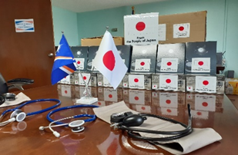
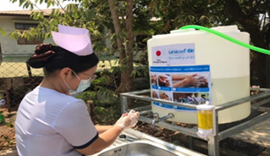
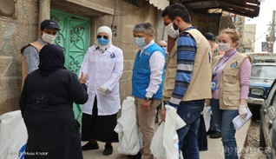
Japan’s aid policies to COVID-19
For Developing countries
Ministry of Foreign Affairs of Japan, September 2020
Overview
Human Security is in crisis facing the spread of infectious diseases.
over $1.54 billion
Providing medical and health assistance bilaterally, and through international organizations.
up to $4.5 billion
Establishing the COVID-19 Crisis Response Emergency Support Loan in order to help revitalize economic activities.
Bilateral
Health care systems
Provision of medical equipment
to more than 83 countries across the globe
($436 million)
X-ray equipment, thermographic cameras, ambulances, etc.
JICA’s technical cooperation
to 38 countries
($13 million)
Japan has provided training for medical workers to prevent infections and control outbreaks in health facilities, including through providing testing equipment and protective gear.
Economic Recovery
COVID-19 Crisis Response Emergency Support Loan
(up to $4.5 billion over the next two years)
As of September 2020, Japan has decided to extend Yen loans to following countries;
･ the Philippines (approx. $450 million)
･Indonesia (approx. $450 million)
･India (approx. $450 million)
･Bangladesh (approx. $320 million)
･Maldives (approx. $45 million) .
Multilateral
Health care systems
via UNICEF
To 66 countries of Asia-Oceania,
the Middle East and Africa
Provision of sanitary goods, training of health care workers on prevention and raising awareness about the risk of infections
via UNDP
To 29 countries of Asia-Oceania,
the Middle East and Africa
Training the capacity of ministries related to health for the development and implementation of health plans
Provision of non-health equipment like electric generator and assistance to health care waste management
via UNHCR
To refugees and other concerned persons
in 17 countries of Asia and the Middle East
Provision of hygiene items, dissemination of COVID-19 information and training of health care workers on infectious diseases
Vaccine
via CEPI
Funding pharmaceutical companies and labs to promote vaccine development and clinical trials
via Gavi
Support for vaccination infrastructure to popularize available vaccine
Medical equipment delivered to the Federated States of Micronesia in July
Technical cooperation to Noguchi Memorial Institute for medical research in Ghana
Installing hand-washing stations
(UNICEF, Myanmar)
Distributing hygiene items
(UNHCR, Syria)

